Slide 1
Dismantling Media Bias against Palestine
MEDLAB Workshop - June 18, 2019
Rania (el) Masri
facebook.com/rania.masri
rania.z.masri@gmail.com
rania.elmasri@lau.edu.lb

Slide 2
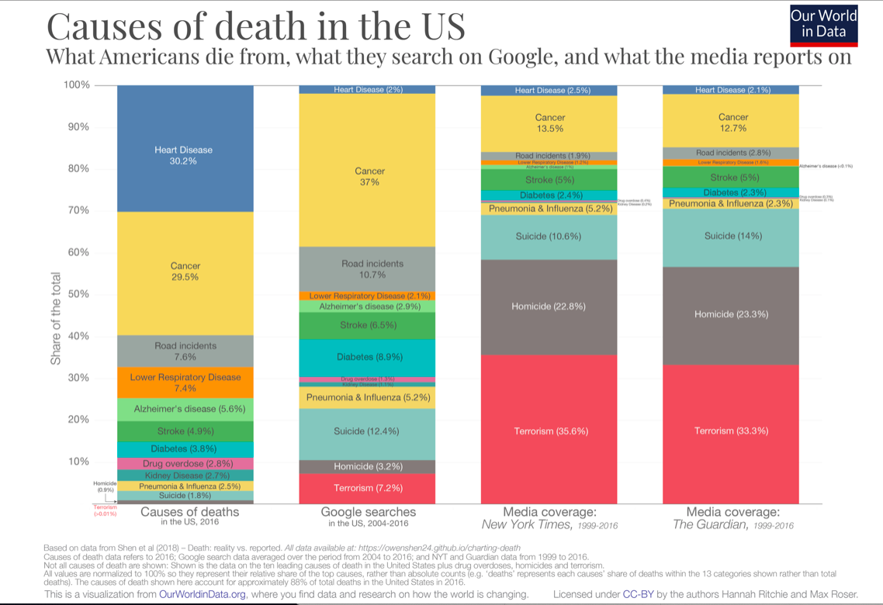

Slide 3
Our plan today (yes?)
1.15 pm - 3.15 pm
brief introduction (5 min)
Identifying bias in popular press articles - in groups (20 min)
Discussing our position on Palestine (20 min)
Discussing media bias (20 min)
Rewriting articles - in groups (20 min)
Tools for us to use and open discussion (20 min)

Slide 4
The Independent. June 7, 2019. “Inside Lebanon’s most dangerous camps: Palestinian refugees who are incarcerated and abandoned”
Human Rights Watch. June 12, 2019. “Gaza: Unlawful Attacks in May Fighting”
الجمهورية. 23 آيار 2019. ”مؤتمو المنامة و حصص لبنان و الشتات الفلسطيني واليهودي
Al Jazeera. June 14 2019. “Israeli jets hit Gaza after rocket fire into Israel.”
The Independent. December 13, 2018. “West Bank: Two Israelis and four Palestinians killed amid bloodiest flare up of violence in months.”
NPR. May 6, 2019. “After Weekend Of Deadly Violence, Reports Of A Truce In Gaza”
CNN. May 5, 2019. “More than 20 reported dead in Gaza, 3 in Israel after hail of rockets and airstrikes.”
BBC News. October 22, 2015. “Is Palestinian-Israeli violence being driven by social media?”
CNN. July 19, 2011. “Palestinians, Israelis trade attacks; tanks sent to West Bank.”

Slide 5
“Israel Defense Forces said it mobilized tanks and armored vehicles to the West Bank area on Tuesday after mortar attacks were fired in Gilo, a Jewish neighborhood just outside Jerusalem…The Israelis consider [Gilo settlement] a Jerusalem suburb and Palestinians consider it occupied territory…The Palestinians blame Israel, saying the Israelis are occupying what they think should rightfully be Palestinian territory.” (CNN, 2001)

Slide 6
“What is happening between Israelis and Palestinians? There has been a spate of stabbings and gun attacks on Israelis by Palestinians since early October, and one apparent revenge stabbing by an Israeli. The attacks, some of which have been fatal, have struck in Jerusalem and in northern and central Israeli cities and towns, and in the occupied West Bank. Israel has tightened security and clashed with rioting Palestinians, leading to deaths on the Palestinian side. There has also been associated violence in the border area inside the Gaza Strip” (BBC, 2015)

Slide 7
Bias evaluation
Headline?
Word choice and tone and active/passive tense?
Selection and omission?
placement? Where in the paper? What info is placed where in the article?
Photos, captions, camera angles? Names and titles?
Statistics?
Source control?

Slide 8
Aggressive, assertive, domineering, dynamic, pushy, forceful
Shrewd, egghead, bright, clever, brilliant, cunning, smart, intelligent, brainy
politician-statesman
domineering – assertive
___ uprising, riot, demonstration, unlawful gathering , protest or disturbance
___ guerrilla, freedom fighter , mercenary , soldier or terrorist
in Arabic?

Slide 9
A study of media coverage of the “Israel-Palestine” issue (from June 1967 to June 2017 ) across 5 major US newspapers found:
Since 1967:
use of the word “occupation” declined by 85% in the Israeli dataset of headlines, and by 65% in the Palestinian dataset;
mentions of Palestinian refugees declined by an overall 93%;
mentions of “East Jerusalem,” distinguishing that part of the city occupied by Israel in 1967 from the rest of the city, appeared only a total of 132 times (from 99,594);
Israeli sources - 250% more likely to be quoted as Palestinians;
Number of headlines centering Israel published 4 times more than those centering Palestine;
Words connoting violence such as “terror” appear 3 times as much as the word “occupation” in the Palestinian dataset;
Coverage around the issue spikes during periods of escalated “violence”/wars.
Explicit recognition that Israeli settlements and settlers are illegal rarely appears in both datasets;
Coverage reduced dramatically in the second half of the 50-year period.
Coverage of Israel and Palestine declined since the Oslo accords in 1993.
FYI: The Los Angeles Times portrayed Palestinians most negatively, followed by The Wall Street Journal, Chicago Tribune, Washington Post, and lastly The New York Times;

Slide 10
What is our position on Palestine?
What do we want?
Is there a neutral space?
A thief. A rapist. An occupier.
Let’s write the framework ourselves - instead of engaging in a framework and dialogue written by the occupier and his friends.
Ghassan Kanafani ….

Slide 11
“women and children”
“unarmed”
“Gazans”
“Arab-Israelis”
“Palestinian cause” - "القضية الفلسطينية "

Slide 12
Let’s (re)write the articles

Slide 13
Tools
Palestinian Oral History Project
https://libraries.aub.edu.lb/poha-viewer/map/?blm_aid=6961228#
https://libraries.aub.edu.lb/poha/
Visualizing Palestine
https://visualizingpalestine.org
https://visualizingpalestine.org/visuals?locale=ar&cat_id=#visuals
https://www.facebook.com/Naastopia/ & https://www.facebook.com/campji/
(Challenges: Facebook? Twitter?)

